Slide 1
04 - Seaborn
Machine Learning

Slide 2
Course Overview:
1.1 - Python Review
1.2 - Numpy
1.3 - Pandas
1.4 - Seaborn
2.1 - ML Intro
2.2 - Linear Regression
2.3 - Logistic Regression
2.4 -Naïve Bayes Classifier
2.5 - KNN
2.6 - Decision Trees
3.1 – Ensembling Learning
3.2 - Neural Networks
4.* - Natural Language Processing (NLP)
5.* Competition Tips & Final Thoughts

Slide 3
DISTRIBUTION PLOTS
01
MATRIX PLOTS
02
TABLE OF CONTENTS
CATEGORICAL PLOTS
03
04
GRIDS AND STYLE
05
REGRESSION PLOTS

Slide 4
What is Seaborn?
A module for data VISUALIZATION, not COMPREHENSION or MODIFICATION.
Seaborn will put your data on graphs - good for beautifying your reports or finding out rudimentary trends.

Slide 5
01
DISTRIBUTION PLOTS

Slide 6
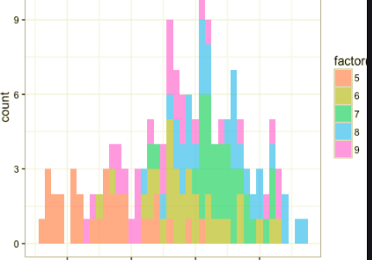
What are DISTRIBUTION PLOTS?
They show the distribution of data across certain intervals (like a histogram or a bar graph)
Source: Towards Data Science

Slide 7
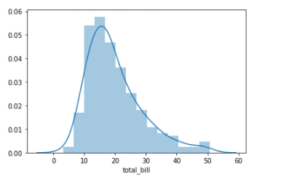
sns.distplot()
sns.distplot(data) - shows you the distribution of values in a certain series
You can remove the KDE line and change the amount of divisions with kde=False or bins=num.

Slide 8
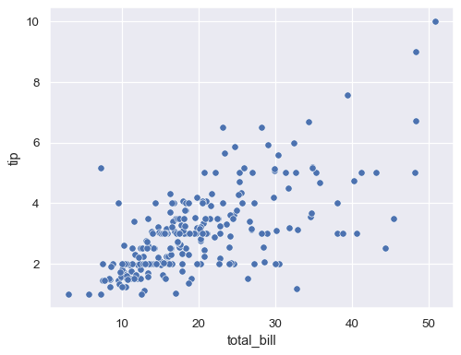
sns.scatterplot()
sns.scatterplot(data, x, y) - creates a scatter plot
data is a DataFrame, while x is the name of one column/row,
and y is the name of another column.
When writing x and y inputs make sure to say x=’column name’,
y = ‘column name’

Slide 9
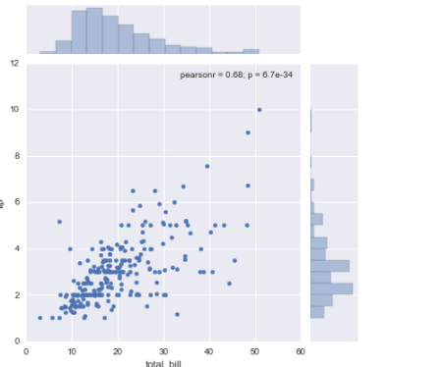
sns.jointplot()
sns.jointplot (x=, y=, data=dataset, kind=)
Uses two datasets to create a graph that uses dots or hues to show the relationship and frequency of two concurrent values
kind can mean anything from “scatter” to “hist” - it’s the type of plot

Slide 10
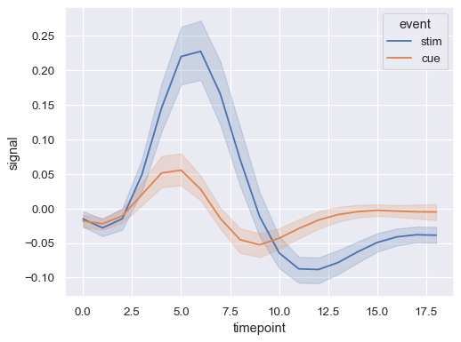
sns.lineplot()
Syntax: sns.lineplot(x=, y=, data)

Slide 11
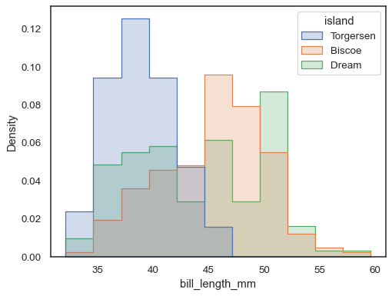
sns.histplot()
Syntax: sns.histplot(data)
Creates a histogram - similar to matplotlib’s
plt.hist()

Slide 12
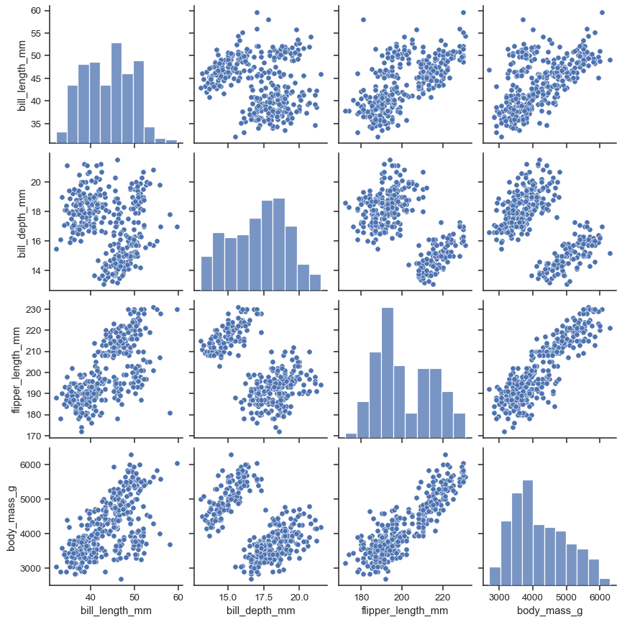
sns.pairplot()
Syntax: sns.pairplot(data)
creates correlative graphs for all data in the datasets
Each column has its own entry in the matrix - and the diagonal holds the graphs with the same column relations

Slide 13
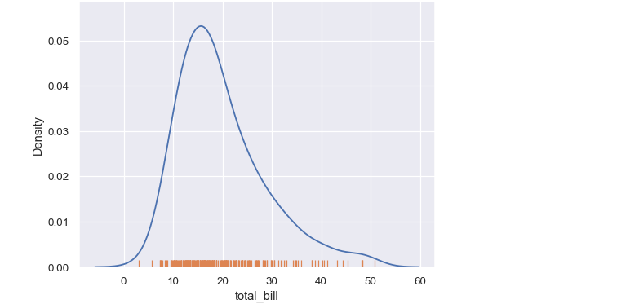
sns.rugplot()
Syntax: sns.rugplot(data=, x=)
Creates a density indicator plot at the bottom of the graph

Slide 14
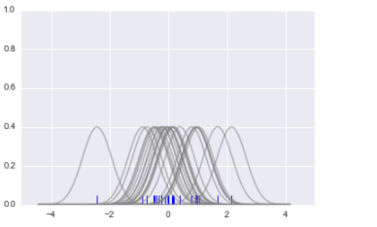
sns.kdeplot()
Turns this (representation of KDE of all points)
… into this (sum of all those graphs)
Syntax: sns.kdeplot(data=, x=)
Creates a plot with the sum of all kernel density estimation plots (value of probability density)

Slide 15
02
MATRIX PLOTS

Slide 16
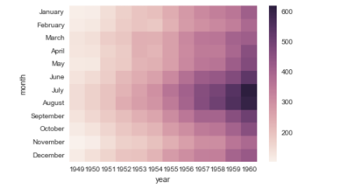
sns.heatmap()
Syntax: sns.heatmap(data)
Visualizes data with different gradients
Data Tips:
For ratio-based heatmaps, use data.corr()
For value based heatmaps with only using two columns in a dataframe, create a pivot table:
Syntax: df.pivot_table(values=, index=, column=)

Slide 17
03
CATEGORICAL PLOTS

Slide 18
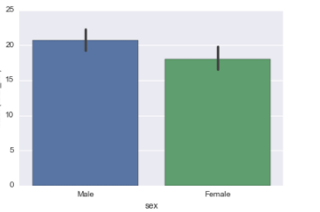
sns.barplot()
Syntax: sns.barplot(x=[column name], y=[column name], data=[dataframe name]) -
aggregates data based of the mean

Slide 19
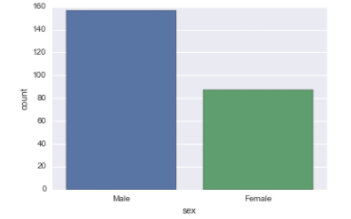
sns.countplot()
Syntax: sns.countplot(x=[column name], data=[dataframe name]) -
Similar to bar plot - but gives value count data instead of aggregation

Slide 20
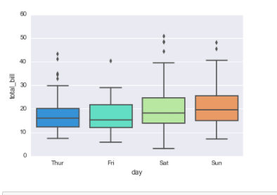
sns.boxplot()
Syntax: sns.boxplot(x=[column name], y=[column name], data=[dataframe name])
Creates a box-and-whisker plot
Useful tip - you can do entire dataframes instead of x and y specifications

Slide 21
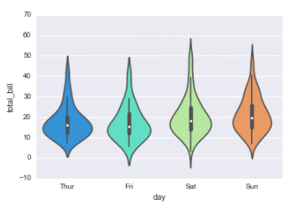
sns.violinplot()
Syntax: sns.violinplot(x=[column name], y=[column name], data=[dataframe name]) -
Graph that uses thickness to represent occurrences and has a KDE

Slide 22
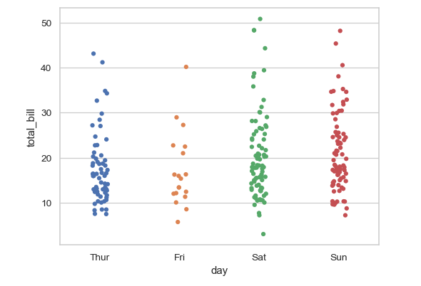
sns.stripplot()
Syntax: sns.stripplot(x=[column name], y=columnname, data=[dataframe name])
creates a small strip of dots for visualisation

Slide 23
04
GRIDS AND STYLE

Slide 24
Quick overview
Grid type plots: they overlay different types of graphs using different columns of a dataframe.
It uses the same plots as other sections but just formats them.

Slide 25
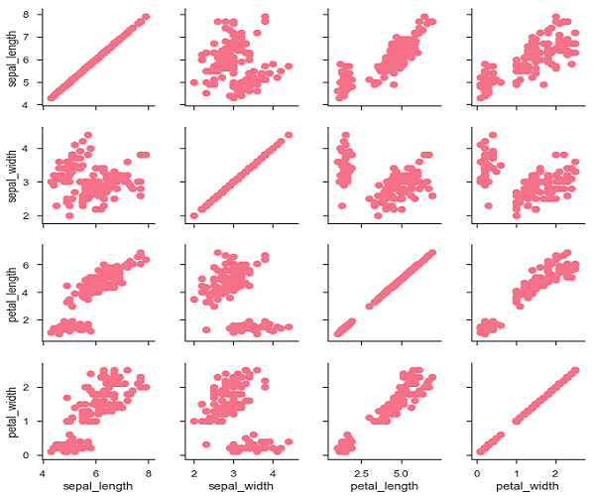
sns.PairGrid()
sns.PairGrid(dataframe)
Then map: [variable name]:
sns.PairGrid(dataframe)
[variable name].map(sns.scatterplot)

Slide 26
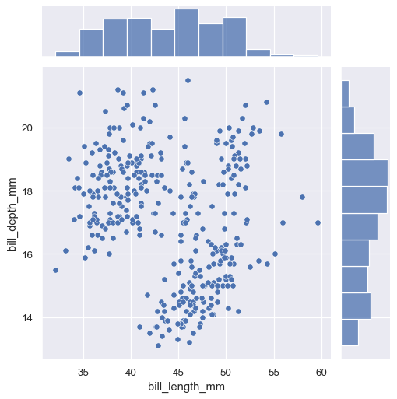
sns.JointGrid()
sns.JointGrid(x, y, data) - use the same variable assignment and then input first the side plot and then the middle plot (like jointplot)

Slide 27
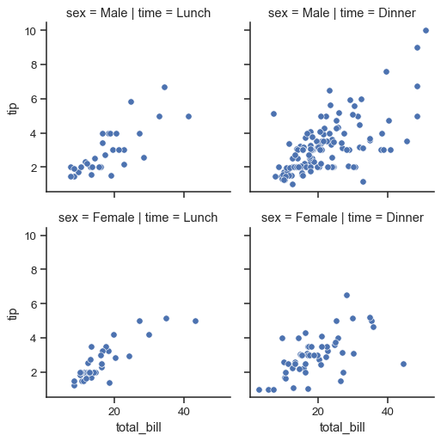
sns.FacetGrid()
sns.FacetGrid(dataframe, col=, row=) - use the map function along with ANOTHER column name to create a graph

Slide 28
A quick example of style:
sns.set_style(“white”) - more examples include “ticks”
sns.despine() - removes lines
Size: plt.figure(figsize(tuple))
sns.set_context(scale, type, etc.) - unconventional terms that usually don’t have their own commands
Note: Style is not something that can be taught in detail! The internet is your best friend for finding specific miniscule style details!

Slide 29
05
REGRESSION PLOTS

Slide 30
Quick overview:
Regression plots are plots that emphasize and visualize PATTERNS in datasets. It is quite useful in an application like machine learning, where you use networks and code to find patterns.

Slide 31
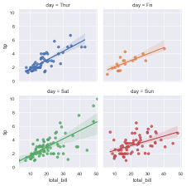
sns.lmplot()
sns.lmplot(x, y, data) - creates a regression plot with a trendline that is used to determine the position of future variables

Slide 32
Thank you!

